Slide 1
New IP Sandbox
Leveraging Linux for the design of applications using New IP open platform

Slide 2
Tutorial Overview
Introduction and Setup
Part 1: Introduction to New IP (motivation and format)
Rationale for New IP
Address Innovation
New IP Contracts
New IP Design on Linux
Part 2: New IP Sandbox Test Environment
Introduction to Linux namespaces and NeST topology creation platform.
NeST Design and Features
Platform for New IP Sandboxing
Part 3: Demonstration of the use cases
Forwarding based on Asymmetric addresses
Developing Contracts latency-aware forwarding.
Platform Capabilities
Part 4: Service extensibility on New IP platform
Extension scenario of latency-aware scheduling and forwarding for multiple time constraint streams.
Wrap up

Slide 3




Presenters
Kiran Makhijani
(Futurewei Tech, USA)
Mohit Tahiliani
(NITK, India)
Bhaskar Kataria
(NITK India)
Lijun Dong
(Futurewei Tech, USA)
Deepta and Shanshak (NITK) for support with tutorial and access to New IP VM

Slide 4
Setup
Slides and VM for hands on portion of the tutorial
https://network2030.github.io/NewIP-Linux/
Access Cloud Account to VM
ssh ubuntu@<ip_address>
Pwd – to be provided
VM Download for your own use
129.154.224.36
144.24.108.91
144.24.115.88
129.154.224.207
152.67.25.130
144.24.103.180
144.24.118.49
129.154.231.126
129.154.227.93
129.154.226.88

Slide 5
New IP Overview
Introduction to New IP (motivation and format)
Basic Specification

Slide 6
Network Requirements
Support for several billions of devices.
Support for a variety of connections
Support for terabytes of high-volume data streams
Translating to Requirements on the Networks
High reliability in machine-centric data delivery
Fine-grained customization of traffic
Guarantees of data delivery
Timeliness, quality, throughput
Loss less flow of traffic between the endpoints
Reliability
New Security aspects
Digital Sovereignty, Preservation of Privacy
Digital Twins & Cyber physical systems.
| Abundant Bandwidth Everywhere
eMBB
mMTC
URLLC
|Connectivity Everything
|Critical Applications and Services
Understand impact of these requirements on the current network architecture
Source: ITU-T IMT-2020

Slide 7
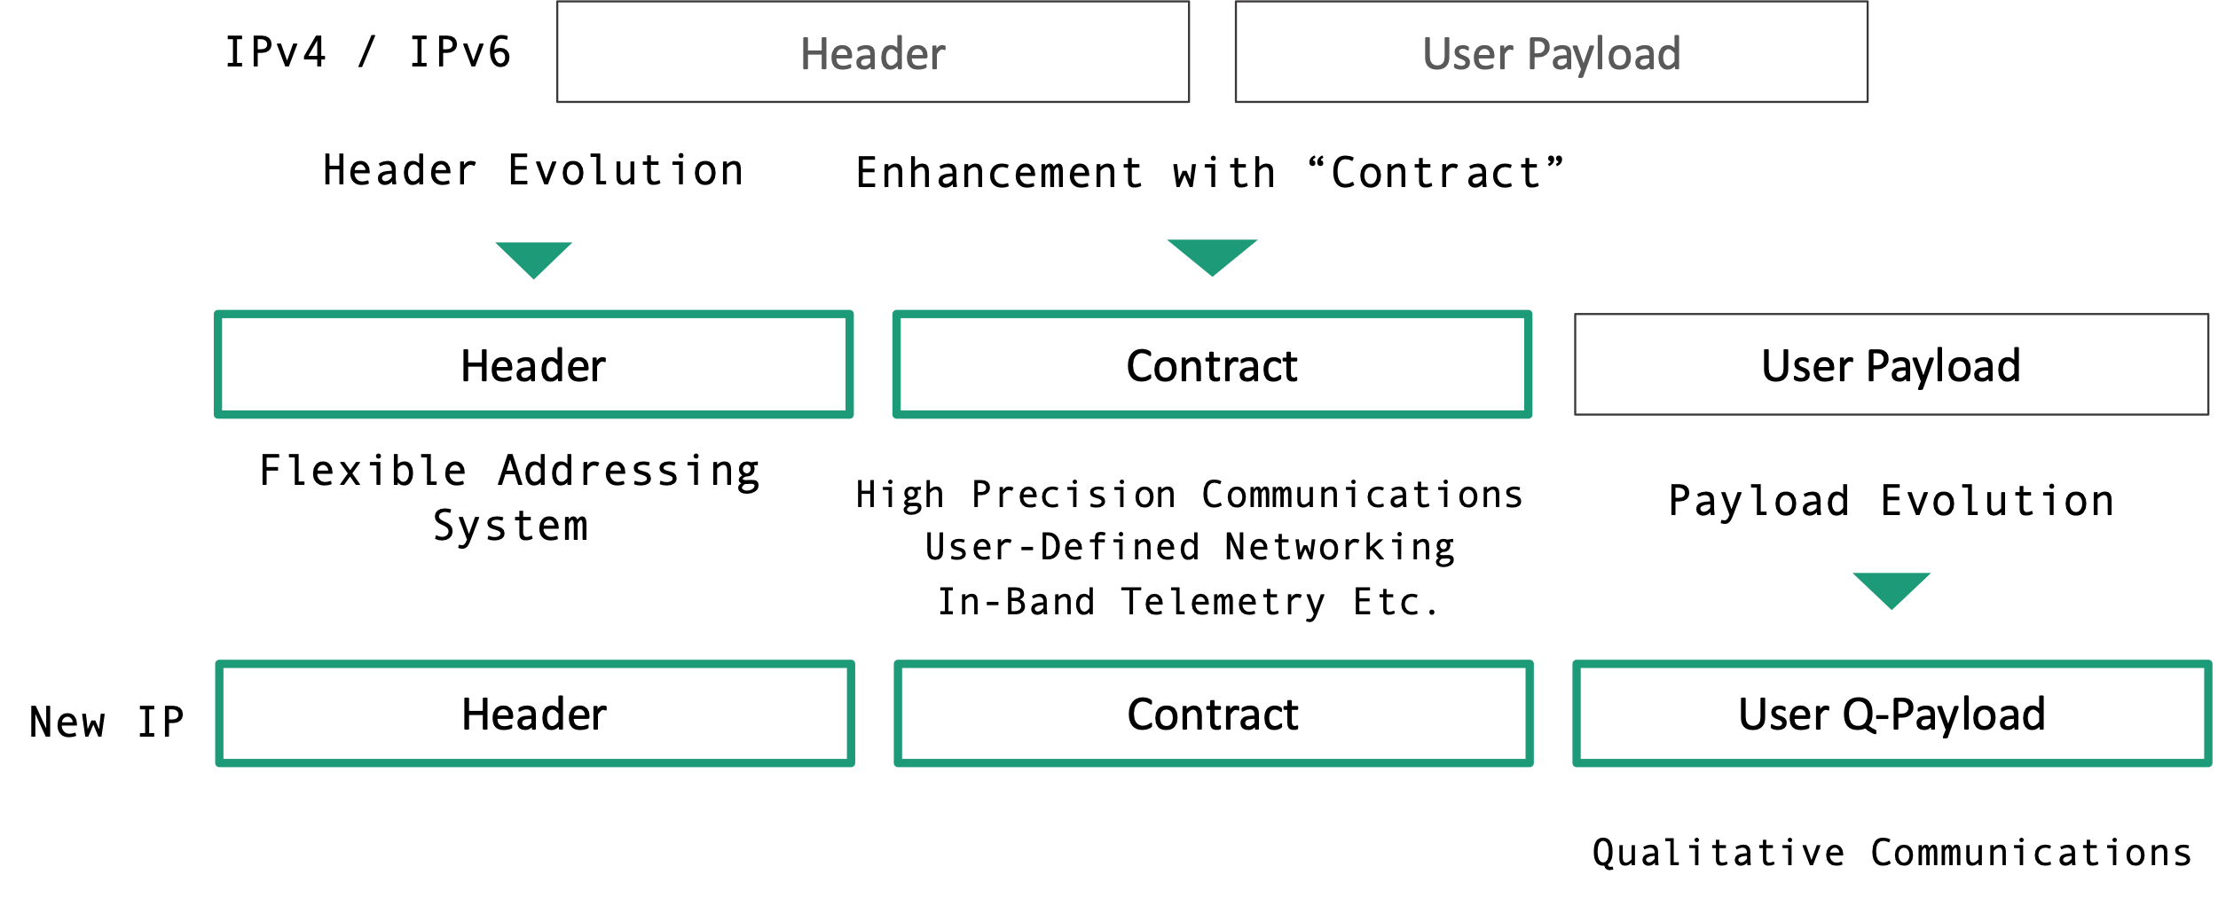
What is New IP?
An abstraction of Network Technologies across different dimensions to enable next-gen application scenarios
Evolutionary Architecture
Self-X Networks
Trustworthiness
High Precision Services
Flexible, Backward Compatible
AI/ML Technologies
Secure routing
New low level service primitives
large-scale network domains
Automation in Mgmt Plane
Customization in Control Plane
Customization in Data Plane
Promotes Holistic approach vs Siloed approach: past few decades network innovation are driven by specific requirement within the constraints of current network architecture
HPC
QC
FAS Sockets
Automation
Transport
Security & Trust
An early stage of concept to support newer applications in evolutionary, flexible and programmable manner
New IP
Layer 2/Data link

Slide 8
New Network Service Primitives
Best Effort
Forward a traffic flow from a network node
Differentiated services
Ingress - Enable classification, Police and mark traffic
Core – Queuing Dropping, Per-hop behavior (PHB) for minimum rate assurance, egress shaping and aggregate traffic
Traffic Engineering
path selection based on constraints on bandwidth
Limitations when dealing with newer applications
Fails to provide throughput guarantees
Fails to provide guarantees of maximum latency (in-time)
Fails to provide guarantees of precise latency (on-time)
Technical Specification:“New Services and Capabilities for Network 2030: Description, Techni​​cal Gap and Performance Target Analysis​” (October 2019) ​
Technical Report: "Network 2030 - Gap Analysis of Network 2030 New Services, Capabilities and Use cases" (June 2020)

Slide 9
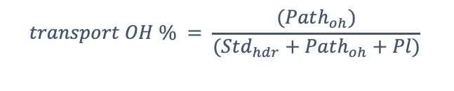
Structured Headers lead to overheads
Tunnel 1
Routing/ Address Headers
͌
Tunnel 2
Service/ Capabilities
͌
$$transport OH \% = \frac{(Path_{oh})}{(Std_{hdr}+Path_{oh}+Pl)}$$
S-Label
payload
C-Label
Integrated services
telemetry
Observations
Services continuously evolve using heterogeneous sets of protocols and functions
Different methods of tunneling, load balancing, congestion control and Quality of Service, firewalls and intrusion detection systems.
With Segment routing TE (MPLS or V6) overheads go up with No of hops.
General overhead for 4-byte packet is very high (with Std TCP/IP hdr included)
Segment routing TE vs MPLS has control plane complexity trade offs.
Example: Transport Backhaul Path overhead

Slide 10
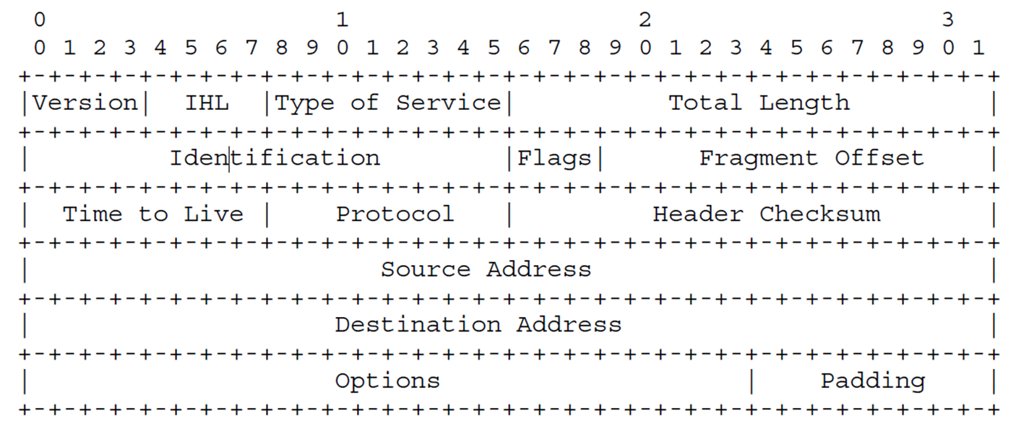
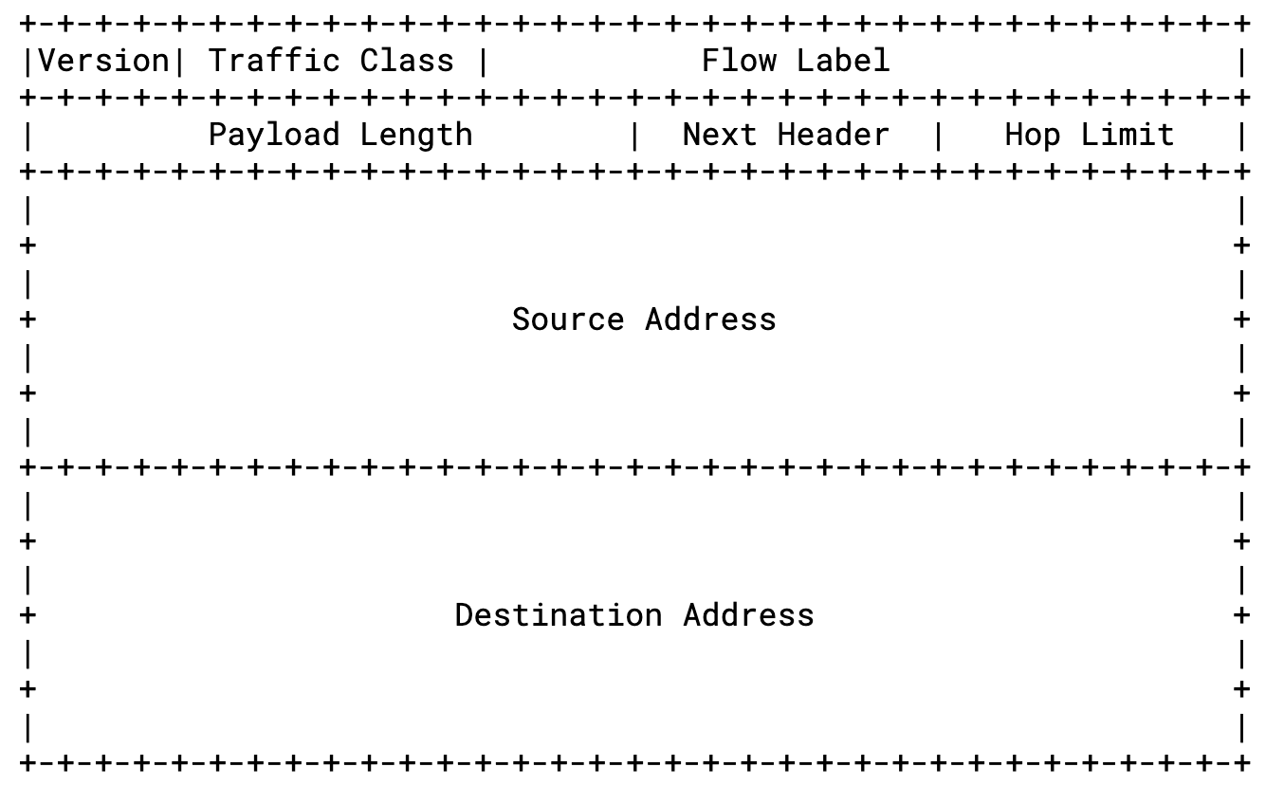
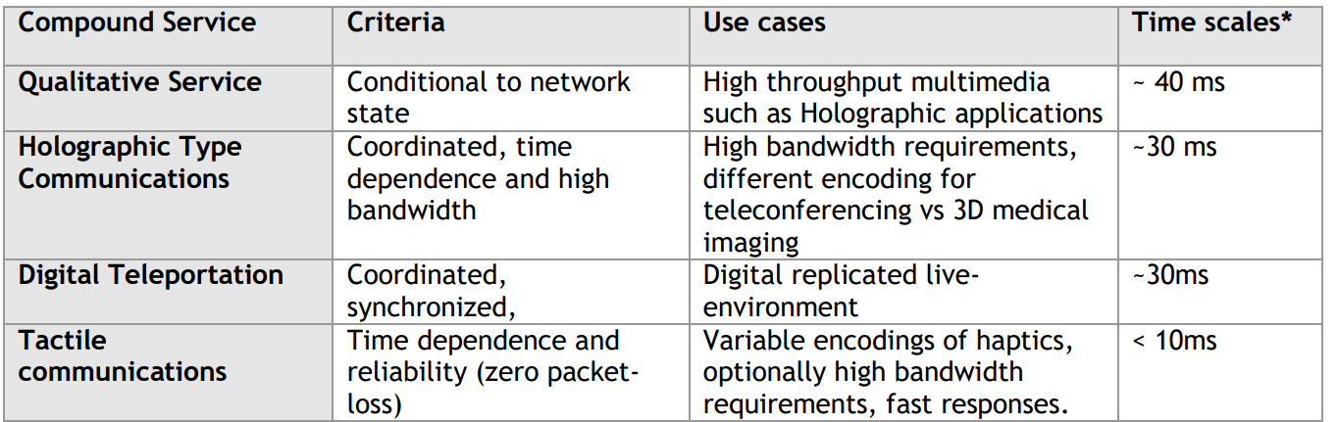
Packet Formats - Services
Missing Information for the Networks and Routers
Throughput for the media application
Latency for the underlying application requires
Other resource requirements the application may have – level of security, path, functions
Additional Primitives: Tracking, Receipt notification, Cost & Energy

Slide 11
Packet Formats - Addresses
There is no ideal fixed-length or format of an address
Smaller networks should not have to carry overheads of larger fixed-sizes
Smaller payloads + smaller headers improve energy efficiency.
Custom address structures protect networks from well-known vulnerabilities
Global Reachability ≠ Global address space
Symmetrical addresses – should source/destination addresses must belong to same address family?
Diverse range of types of end hosts. E.g., IoT devices need energy efficiency, chunks of distributed media content needs descriptive addressing.
Notes:
The current structure of the addresses imposes homogenous addressing scheme. Both end points must have the same address

Slide 12
Packet Format – Qualitative Payload
Network is blind to Semantics associated with the packets
Payload itself is treated as raw, uninterpreted, unchangeable.
The tolerance to packet losses in the volumetric media applications is extremely low, and the problem
Means to support Qualitative Communications
Network perceives the semantics of the packet payload, e.g., boundary, importance variation, relationship among different parts in the packet;
The unit of action taken by the network does not need to be on the entire packet.
E.g. achieving near linear throughput, if packet losses due to congestion are eliminated.
Notes:
Payload itself is treated as raw, uninterpreted, unchangeable, and lacks intelligent treatments inside the network. When a packet gets dropped or lost completely.
if the network can perceive the semantics of the packet payload, e.g., boundary, importance variation, relationship among different parts in the packet; then the unit of action taken by the network does not need to be on the entire packet, but only on a part of the packet. This may help eliminate re-transmissions in the networks and yet being able to supply data to the receiver with a tolerable quality.

Slide 13
Basic Structure of the New IP Packet
From these observations we conclude that the evolution of the network layer itself is necessary for innovations in the data plane and forwarding planes technologies.
Our proposal is very simple
It describes a packet format that evolves independently across several dimensions.
It maintains network layer as universal – accommodating all types of communications
Is backward compatible
The specification for the new packet format:
The structure is defined using the “Header Spec”
Shipping (Addressing and Reachability functions)
Contract Spec (service specific goals)
Payload Spec (packetization of user payload)
Header Spec is a very small header with offsets to other parts of the structure

Slide 14
New IP Shipping Spec
key features: (a) flexible address format scheme, (b) backward compatible, and (c) hybrid addressing.
Hybrid addressing is supported by allowing both source and destination formats to be specified independently
Address Type (AT) field is the first field routers or nodes look at.
For backward compatibility, AT will use reserved mnemonics such as IPV4, V6, MPLS etc. Then the remaining packet is the classic IP/MPLS.
Otherwise AT can reflect combination of source and destination address types.
Address-cast (Acast) describes communication patterns such as unicast, groupcast, multicast, coordinated-cast etc.

Slide 15
New IP Shipping Spec Examples
Backward Compatibility
For example, IPv4 and MPLS in New IP
In these cases AT will use reserved mnemonics such as IPV4, V6, MPLS etc. Then the remaining packet is the classic IP/MPLS.
Asymmetric Addresses in Shipping Spec

Slide 16
New IP - Contract
A contract is service specification of a service associated with the packet.
It can be optional. Then the contract offset will be set as NA.
Event and Conditions specify when Action take place. – tremendous potential for the research and development of data plane technologies
It can be composed of one or more clauses; Each clause will be a high-level data plane action. For example, in order to support Ultra-Reliable Low Latency (uRLLC) in 5G, two contracts C1 and C2 can be used.
C1 contract clause indicates the BoundedLatency action, and clause
C2 has action NoPktLoss i.e., the low latency and reliability are to be met.

Slide 17
New IP – Q-Payload
The Payload specification is used to support qualitative payload.
The Type field indicates whether it is a traditional or Q-payload.
Q-payload itself needs support from Contract Specification to describe actions on Q-payload.
For example
Wash: a generic operation to arbitrarily or selectively remove the bits/bytes inside the packet payload. For example, remove every 8th bit, remove every fifth byte, etc.
Repair and Recover: can salvage lost portions from the residual payload based on context present along with the action.
Enrich: The re-insert lost portions with locally cached chunks when the network condition improve.
Notes:
The Payload Spec supports Q-Payload. In order to capture the context, it utilizes NewIP contracts. And Q-Payload specific new actions are defined as
Wash, through which selective portions of bits from the packets can be removed
Repair allows Q-paloads to recover the lost data at a different node in the network.

Slide 18
New IP Conceptual Packet Processing Pipeline
Lookup Tables
IPv4
16-bit
Transit/Runtime state
IPv6
8-bit
params
state
params
state
Ingress Packet
Shipping Spec Parser Engine
Contract spec Engine
Egress processing
New IP out
Scheduler
New IP
Classification
LBF
Ping
CC
contract

Slide 19





Developing New IP Forwarding Platform
IP only network
New IP Nodes
Contract insertion
Address insertion
Queue Contract Scheduling
Shipping Spec processing
Remove/ Process Contract
End point Library
Packet processing and forwarding in network nodes
End point Library

Slide 20
Design Principles
Since New IP Packet format is new and carries a lot of intelligence, it was important to understand those processing overheads from
Design and over all implementation framework perspective
From performance and ease of development
More Focus on packet processing/ not hardware
Emphasis on Fast and flexible test and verification environment
Our Platform choice – Linux with network name spaces
Reuse not reinvent
Linux gave us a very stable environment and a plethora of tools and features.
Very short learning curve
NeST provides meets all the above design considerations

Slide 21
References
Technical Specification: “New Services and Capabilities for Network 2030: Description, Techni​​cal Gap and Performance Target Analysis​” (October 2019) ​
Technical Report: "Network 2030 - Gap Analysis of Network 2030 New Services, Capabilities and Use cases" (June 2020)
R. Li, K. Makhijani and L. Dong, "New IP: A Data Packet Framework to Evolve the Internet : Invited Paper," 2020 IEEE 21st International Conference on High Performance Switching and Routing (HPSR), 2020, pp. 1-8, doi: 10.1109/HPSR48589.2020.9098996.
K. Makhijani and L. Dong, "Asymmetric Addressing Structures in Limited Domain Networks," 2021 IEEE 22nd International Conference on High Performance Switching and Routing (HPSR), 2021, pp. 1-7, doi: 10.1109/HPSR52026.2021.9481811.
IEEE GLOBECOM 2019: Richard Li, “IP: GOING BEYOND THE LIMITS OF THE INTERNET”
6G RESEARCH VISIONS, NO. 6
White paper on 6G networking, Led by Tarik Taleb. https://www.6gchannel.com/items/6g-white-paper-networking/

Slide 22
Network Stack Tester
(NeST)
New IP Sandbox Test Environment

Slide 23
What is NeST?
A Python package to emulate networks
Uses network namespaces to simplify the process of setting up networks
Provides intuitive APIs to
Build a virtual network topology
Run experiments on the virtual network topology
Collect statistics
Plot results

Slide 24
Why NeST?
Simplifies the process to reproduce network experiments
Less physical resources, less error prone and less prerequisites
Multiple instances of the same network topology can co-exist, and different experiments can be run in parallel on every instance
NeST assigns random names to the network namespaces
Cleans up the environment (deletes network namespaces) on termination
Open source tool released under GPLv2 License

Slide 25
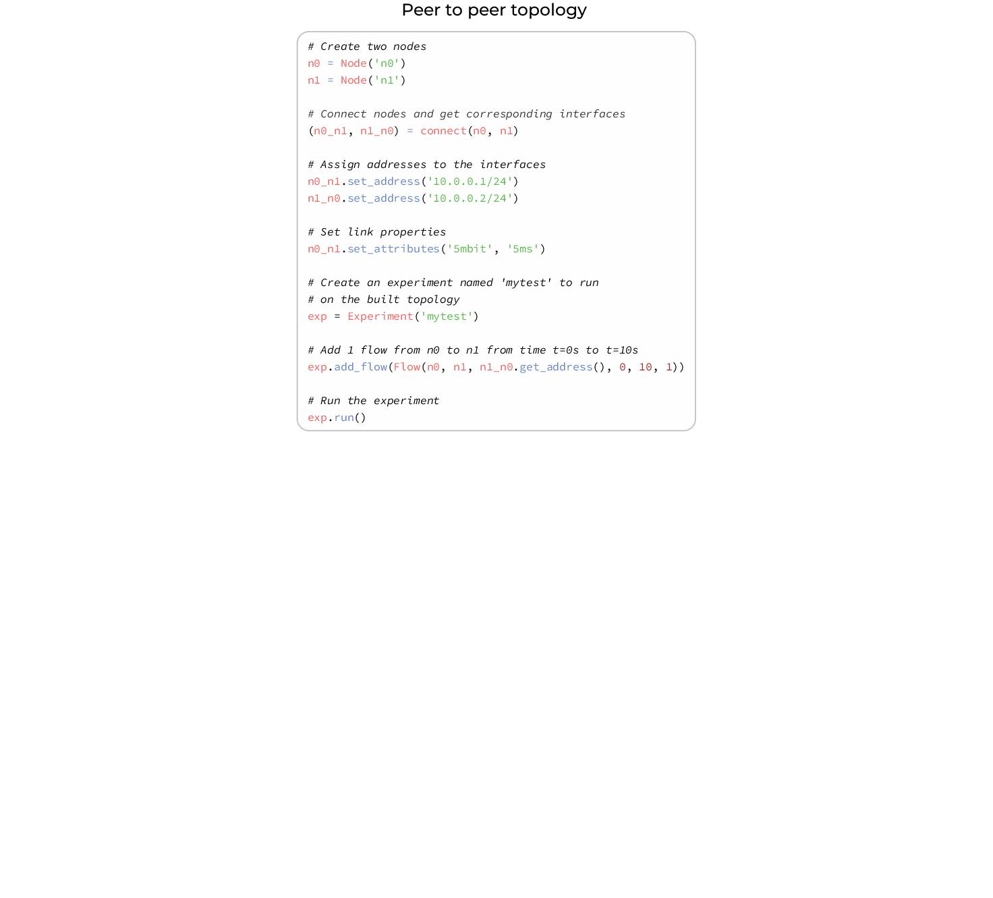

Slide 26
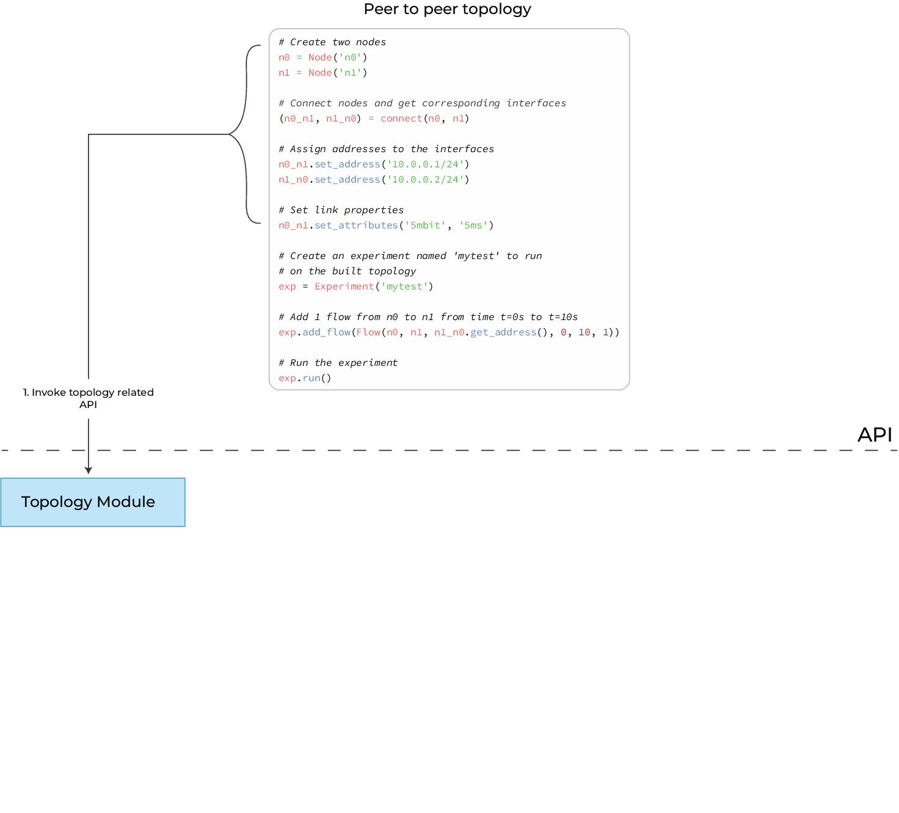

Slide 27
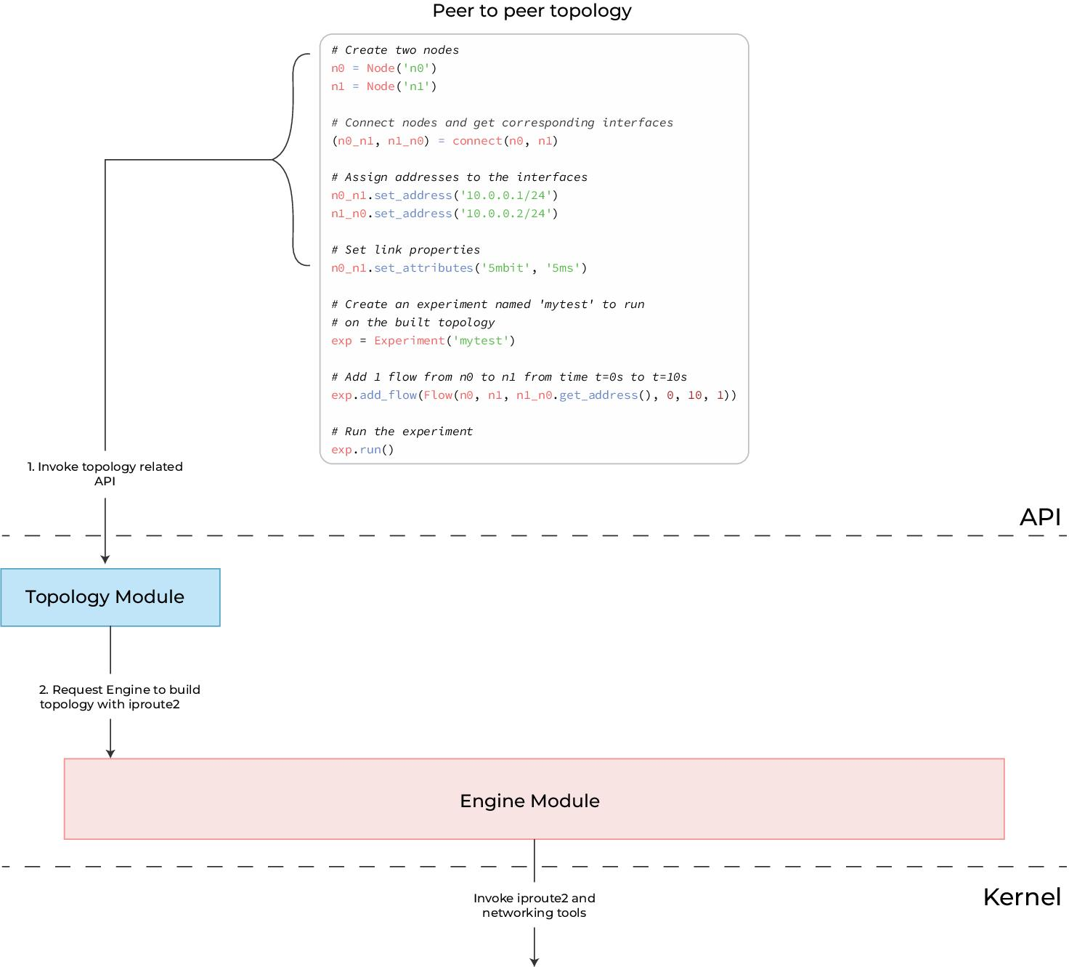

Slide 28
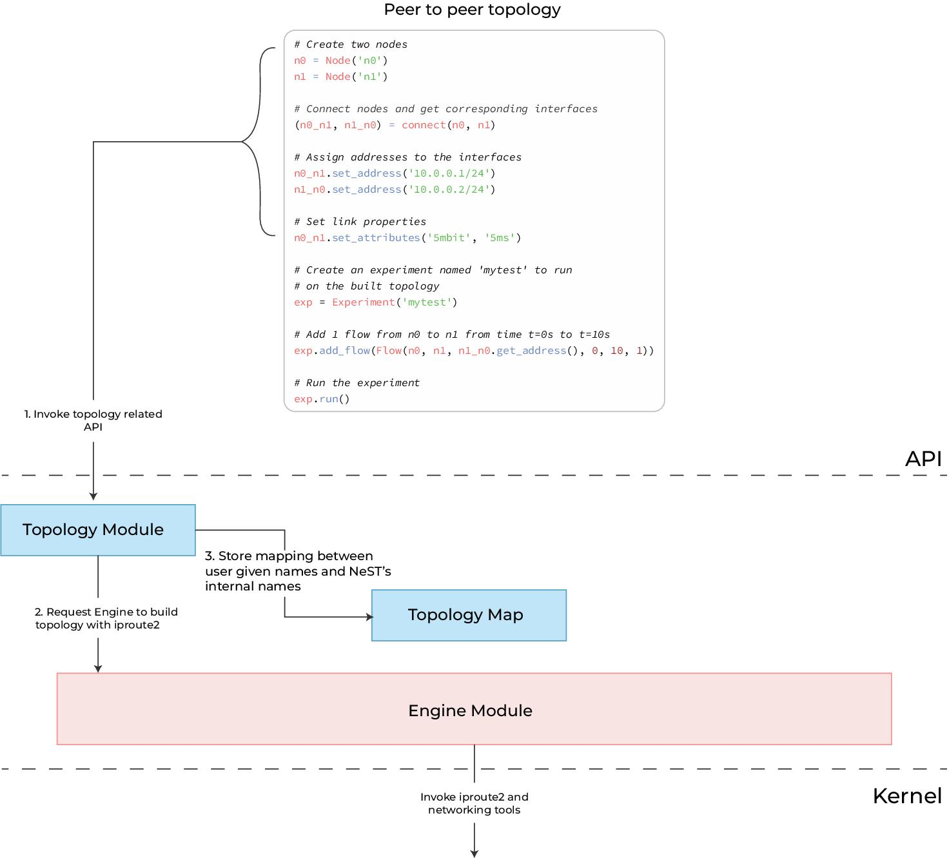

Slide 29
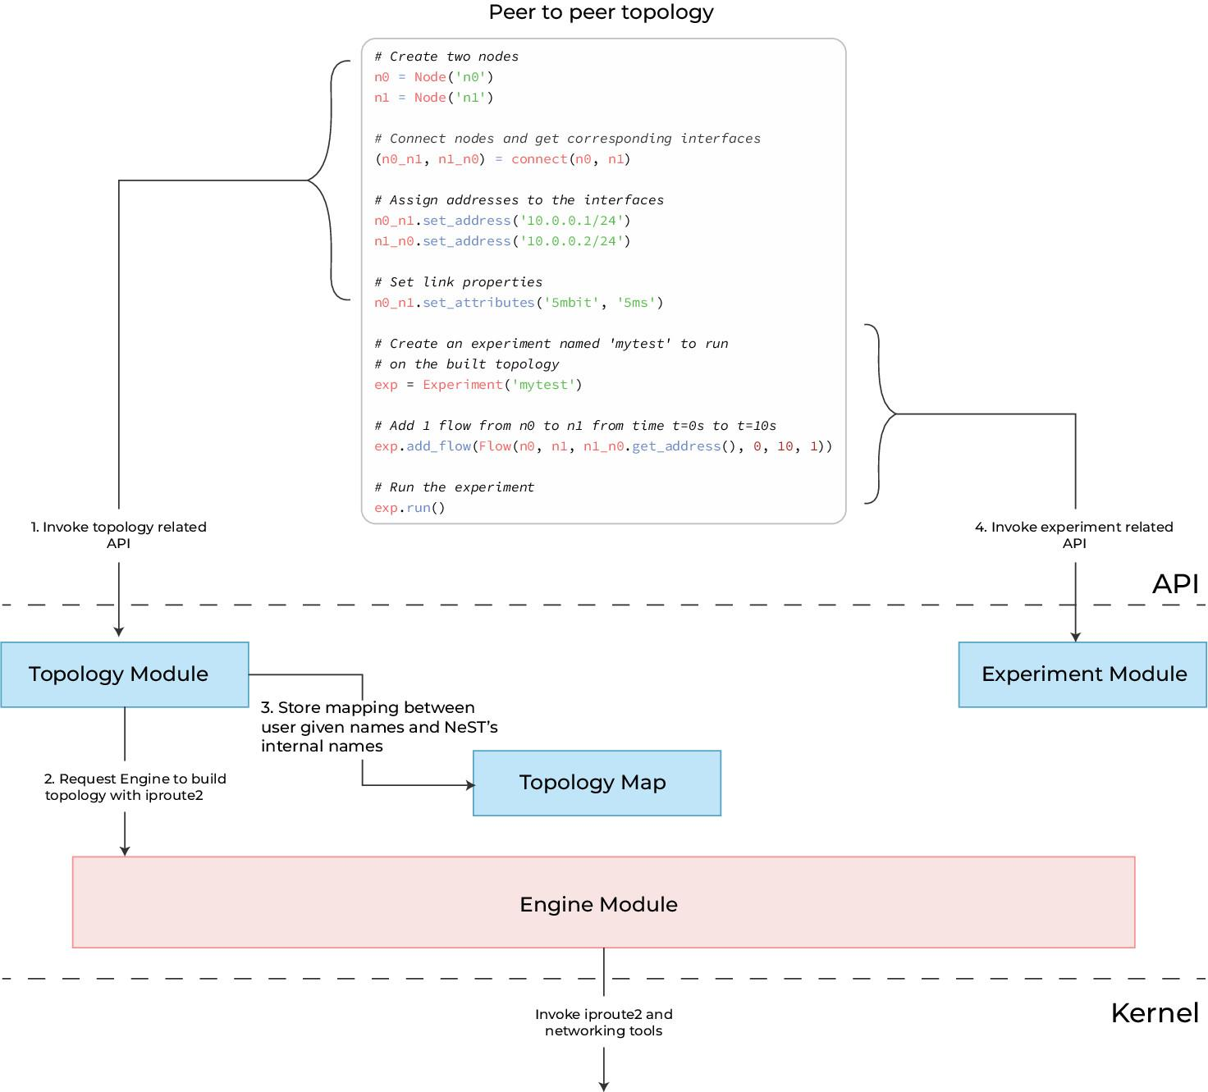

Slide 30
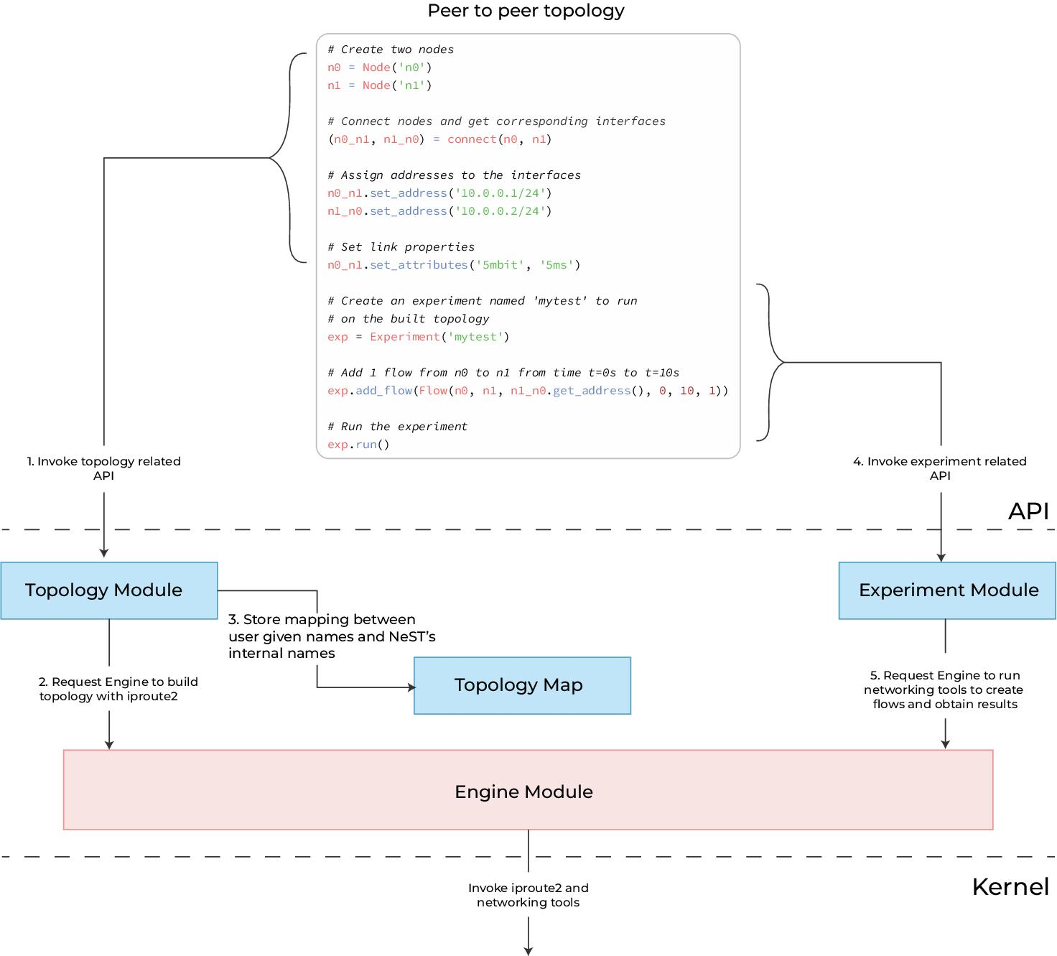

Slide 31
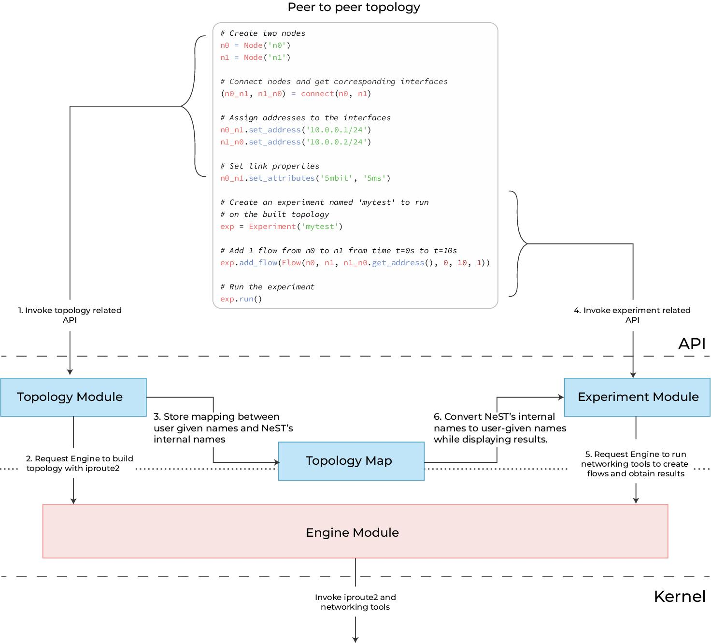

Slide 32
PoC of New IP Demonstration of the use cases
Bhaskar Kataria
Rohit M. P Leslie Monis
Mohit P. Tahiliani
NITK Surathkal
Kiran Makhijani
Futurewei, USA

Slide 33
Goals
Implement a programmable data plane for New IP packet processing
Address customization: applications and routers should be able to forward packets between hosts with different address formats.
Design an end-to-end model to meet service delivery guarantees: routers should be able to process various in-network New IP contracts as described by the applications.
Rapid experimentation of the New IP components should be possible.
Notes:
Change font

Slide 34
IP packet flow in Linux

Slide 35
Main Components
Topology setup - Network Stack Tester (NeST)
Scapy - Host side API
eXpress Data Path XDP - shipping and contract processing
Traffic Control-BPF (TC) - LBF queue discipline

Slide 36
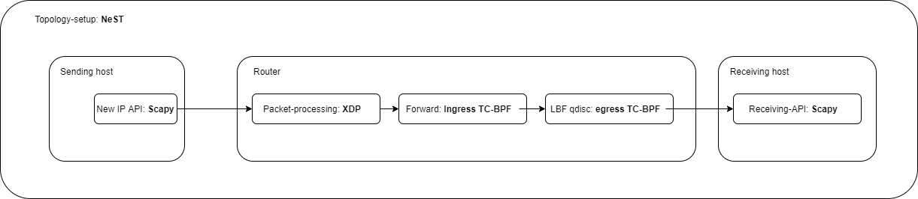
New IP packet flow

Slide 37
Topology setup: NeST
NeST is a python3 package designed for emulating real-world networks
Uses Network namespaces to create the topology
Makes testing easier
For this project, NeST is used to:
Assign IP addresses to the nodes
Populate the routing tables
Form the packet by providing necessary information like MAC addresses
Notes:
Replace for newIP with statement in next slides

Slide 38
Host side API: Scapy
Python library for powerful interactive packet manipulation
Helps forming custom packet formats
Uses Raw sockets internally
For this project, Scapy is used to:
Craft and send the packets from the virtual interface setup by NeST
Sniff and decode the packet at the receiver

Slide 39
XDP
XDP is an eBPF based high performance data path
Merged in the Linux kernel
Provides packet processing at the lowest point in the software stack
For this project, XDP is used to:
Update the Ethernet header in the packet
Identify the interface from which the packet is to be sent using kernel routing tables or BPF maps
Store the exit interface index (ifindex) in metadata of the packet
Pass the packet on to the TC BPF hook

Slide 40
TC-BPF
BPF programs attached to the traffic control (tc) ingress and egress hook
Runs after the networking stack has done the initial processing of the packet
Has access to the metadata of the packet
For this project, TC-BPF is used to:
Add our queueing discipline (we cannot have queue discipline with just XDP)
Read the ifindex from metadata at ingress hook
Redirect the packet to the egress hook of the interface associated with ifindex
Run our queue discipline on the egress hook

Slide 41
Latency Based Forwarding (LBF)
Designed by Toerless Eckert (toerless.eckert@futurewei.com), Alexander Clemm (alex@futurewei.com)
Delivers packets within bounded latency (both minimum and maximum)
Uses number of hops to determine how much time the packet should wait at a node
Experienced delay stored in the packet so no need of clock synchronization
LBF contract packet includes Minimum delay, Maximum delay, experienced delay, fib_todelay, fib_tohops
Users provide Minimum and Maximum delay
Implemented as Linux Kernel module
Can be loaded using TC

Slide 42
Principles
Ideally, the packet should spend number of hops/minimum delay (fib_tohops/min_delay) at each hop
Time to be spent at each hop = (minimum delay - delay experienced)/number of hops left
If experienced delay greater than maximum delay then drop the packet
Packet is dropped if the number of hops exceed the expected number of hops

Slide 43
Example 1
4 nodes (0, 1, 2, 3)
number of hops = 3
minimum delay = 300ms
no queueing delay
At node 0: packet delayed by LBF = (minimum delay - experienced delay)/number of hops = (300 - 0) / 3 = 100ms
At node 1: (300 - 100) / 2 = 100ms
At node 2: (300 - 200) / 1 = 100ms

Slide 44
Example 2
4 nodes (0, 1, 2, 3)
number of hops = 3
minimum delay = 300ms
Queueing delay = 50ms at every queue
At node 0: packet delayed by LBF = (minimum delay - experienced delay)/number of hops = (300 - 50) / 3 = 83ms
At node 1: (300 - (83 + 50 +50)) / 2 = 58.5ms
At node 2: (300 - (83.5 + 50 + 50 + 50 + 58.5) / 1 = 8ms

Slide 45
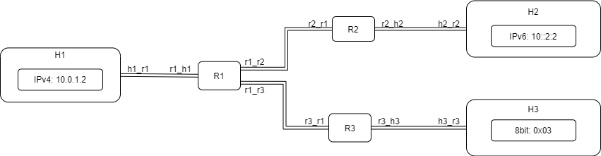
Topology Setup - NeST

Slide 46
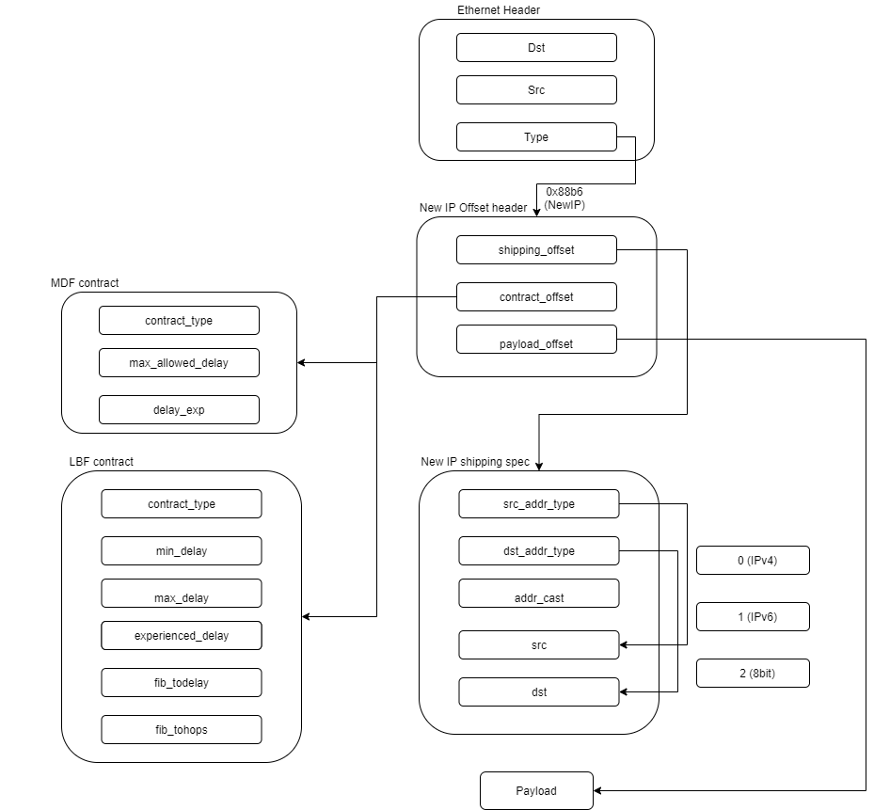
New IP Packet

Slide 47
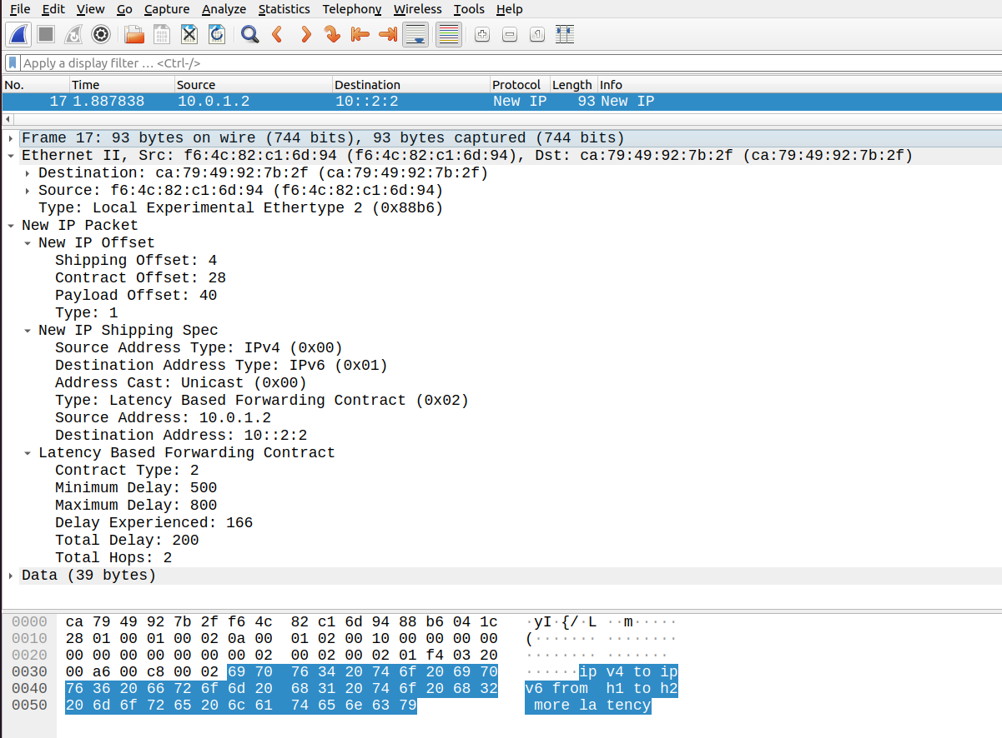
New IP Packet in Wireshark

Slide 48
API for Crafting a New IP packet
sender_obj = Sender()
sender_obj.make_packet(src_addr_type="ipv4", src_addr="10.0.1.2", dst_addr_type="ipv6", dst_addr="10::2:2",content="ipv4 to ipv6 from h1 to h2 more latency")
lbf_contract = LatencyBasedForwarding(min_delay = 500, max_delay = 800, fib_todelay = 0, fib_tohops = 3)
sender_obj.set_contract ([lbf_contract])
sender_obj.send_packet(iface='h1_r1', show_pkt=True)

Slide 49
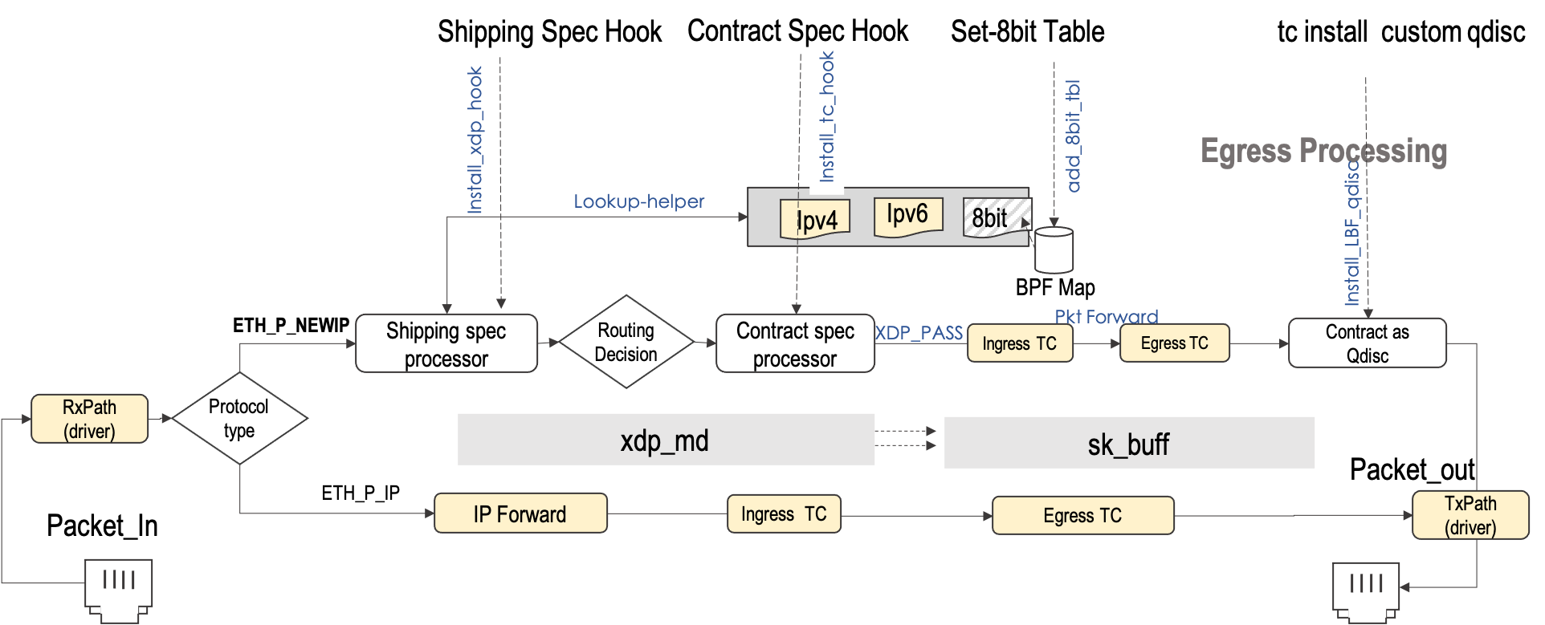
New IP Packet processing

Slide 50
New IP Use cases
Service extensibility on New IP platform

Slide 51
Part II: Some Examples of New IP Use Cases
Optimal Latency Guarantee for Multiple Concurrent Packets
Qualitative Communication
Information Exchange Oriented Vehicle Clustering
And many more

Slide 52
Statistical Multiplexing to Computational Multiplexing
Statistical multiplexing does not work at a packet level. They do not distinguish among packets on whether they are latency-sensitive or not, thus do not treat the latency-sensitive packets differently.
Compared to statistical multiplexing in the current Internet, a computational multiplexing concept is proposed in New IP.
For a latency-sensitive packet, the precise location in the outgoing queue based on its time constraint can be computed, such that the scheduling order of all latency-sensitive packets can be determined.
Computational scheduling takes into consideration of per-packet timing data at a finer granularity as compared to flow-level granularity.
With computational multiplexing, simultaneously arriving packets on same output ports are scheduled deliberately in order to satisfy their deadlines if they are specified in the packets.

Slide 53
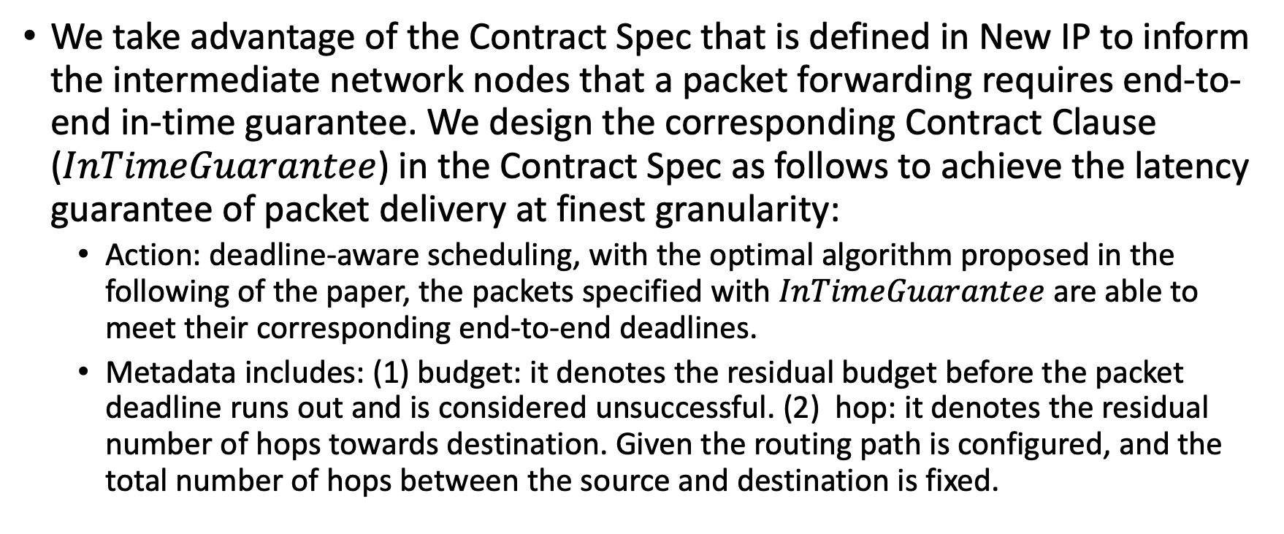
New IP Contract Design
We take advantage of the Contract Spec that is defined in New IP to inform the intermediate network nodes that a packet forwarding requires end-to-end in-time guarantee. We design the corresponding Contract Clause ($InTimeGuarantee$) in the Contract Spec as follows to achieve the latency guarantee of packet delivery at finest granularity:
Action: deadline-aware scheduling, with the optimal algorithm proposed in the following of the paper, the packets specified with $InTimeGuarantee$ are able to meet their corresponding end-to-end deadlines.
Metadata includes: (1) budget: it denotes the residual budget before the packet deadline runs out and is considered unsuccessful. (2) hop: it denotes the residual number of hops towards destination. Given the routing path is configured, and the total number of hops between the source and destination is fixed.

Slide 54
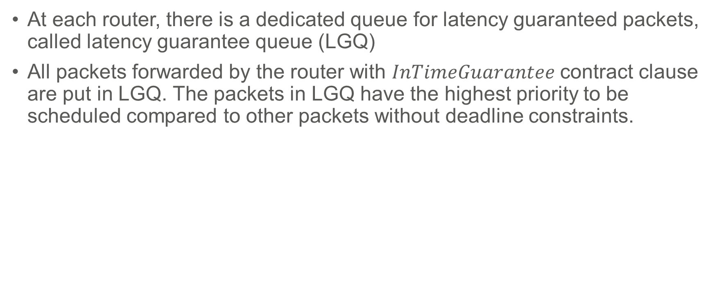
Dedicated LGQ for Latency Guaranteed Packets
At each router, there is a dedicated queue for latency guaranteed packets, called latency guarantee queue (LGQ)
All packets forwarded by the router with $InTimeGuarantee$ contract clause are put in LGQ. The packets in LGQ have the highest priority to be scheduled compared to other packets without deadline constraints.

Slide 55
Motivation
From a router’s perspective, it may have more than one packet (multiple packets) that require latency guarantee. The scheduling of those packets matters.
If FIFO is adopted, some packets in LGQ may miss the deadline.
The time that a packet spent at a router before it is forwarded to the next hop (called as dwell time)includes
Processing delay: likely fixed (we do not consider in the document)
Queueing delay: affected by packet scheduling in LGQ.
Transmission delay: affected by the size of the packet, proportional to the packet size.
The average dwell time determines averagely how long a packet stays in a router before its last bit gets transmitted completely.
Although previously proposed scheduling policy may be able to satisfy the deadline requirements of the packets, they did not consider how transmission delay affects the scheduling.
A packet scheduling algorithm that adopts the computational multiplexing enabled by New IP could be designed, which considers both the packet transmission delay and deadline requirement, achieve the minimal average dwell time.

Slide 56
Step by Step to Illustrate TDMS
Packets | Deadline | Transmission Time
p1 | 10 | 5
p2 | 14 | 2
p3 | 15 | 1
p4 | 6 | 3
Line 2: sort packets by decremental order of transmission time
Outer loop 1
Outer loop 2
Packets | Deadline | Transmission Time
p1 | 10 | 5
p4 | 6 | 3
p2 | 14 | 2
p3 | 15 | 1
TDMS | Deadline | Transmission Time
p2 | 14 | 2
TDMS | Deadline | Transmission Time
p1 | 10 | 5
p2 | 14 | 2
Total transmission time of set J₁ is 5+3+2+1=11, the last packet in the TDMS schedule must be the packet with the largest transmission time that meets its deadline, which is p2.
Total transmission time of set J₂ is 5+3+1=9, the last packet in the TDMS schedule must be the packet with the largest transmission time that meets its deadline, which is p1.
Outer loop 3
Outer loop 4
TDMS achieves minimal average dwell time, which is (1+4+9+11)/4=25/4=6.25
TDMS | Deadline | Transmission Time
p4 | 6 | 3
p1 | 10 | 5
p2 | 14 | 2
TDMS | Deadline | Transmission Time
p3 | 15 | 1
p4 | 6 | 3
p1 | 10 | 5
p2 | 14 | 2
Total transmission time of set J₃ is 2+1=3, the last packet in the TDMS schedule must be the packet with the largest transmission time that meets its deadline, which is p4.
Total transmission time of set J₄ is 1. The only left packet is p3, which is put in the very front of the queue. Return TDMS.
56

Slide 57


Integrity of Packet
Sender
Receiver
Syntax
What is received What is sent
Every bit and byte has the same significance to routers/switches
Packet
Packet
Good for
File/Document Transfer
Banking, Shopping
Overkill for some applications
Video
Holograms
Packet
Corrupted Packet
57
Icon made by Freepik from www.flaticon.com

Slide 58
Cost of retransmissions due to packet dropping
When reliable transport layer protocol is used, packet drops result in the retransmission of the packet.
Sender
Receiver
Cost of re-transmissions
Wastes network resources
Reduces the overall throughput,
Unpredictable longer delays.
t₀
P₁ sent
t₀
t₁
t₁
RTO for P₁
t₂
Timeout or Dup ACKs (lost segment)
t₂
Retransmit P₁
t₃
t₃

Slide 59
Qualitative Communication: A structure of bits and bytes
Sender
Receiver
Semantics
What is received What is maximally meant
In payload, bits and bytes are not equally significant. Instead, they are different in their entropies
Less significant bits and bytes may be dropped
Partial or degraded, yet useful, packets may be repaired and recovered before being rendered
Good for
Large volume of image-like data
Holographic type communications
Media with digital senses
Disaster Environment

Slide 60
Qualitative Communication: an example for illustration only
User Data Payload: Divided into 8 chunks.
Contract:
Event: Congested OR Radio Unstable
Action: Packet Wash
Meta-Data: Chunk 1, Chunk 2, chunk 6, Chunk 7, Chunk 8
On congested node: after cut
Packet Wash is preferred to drop-and-retransmit

Slide 61
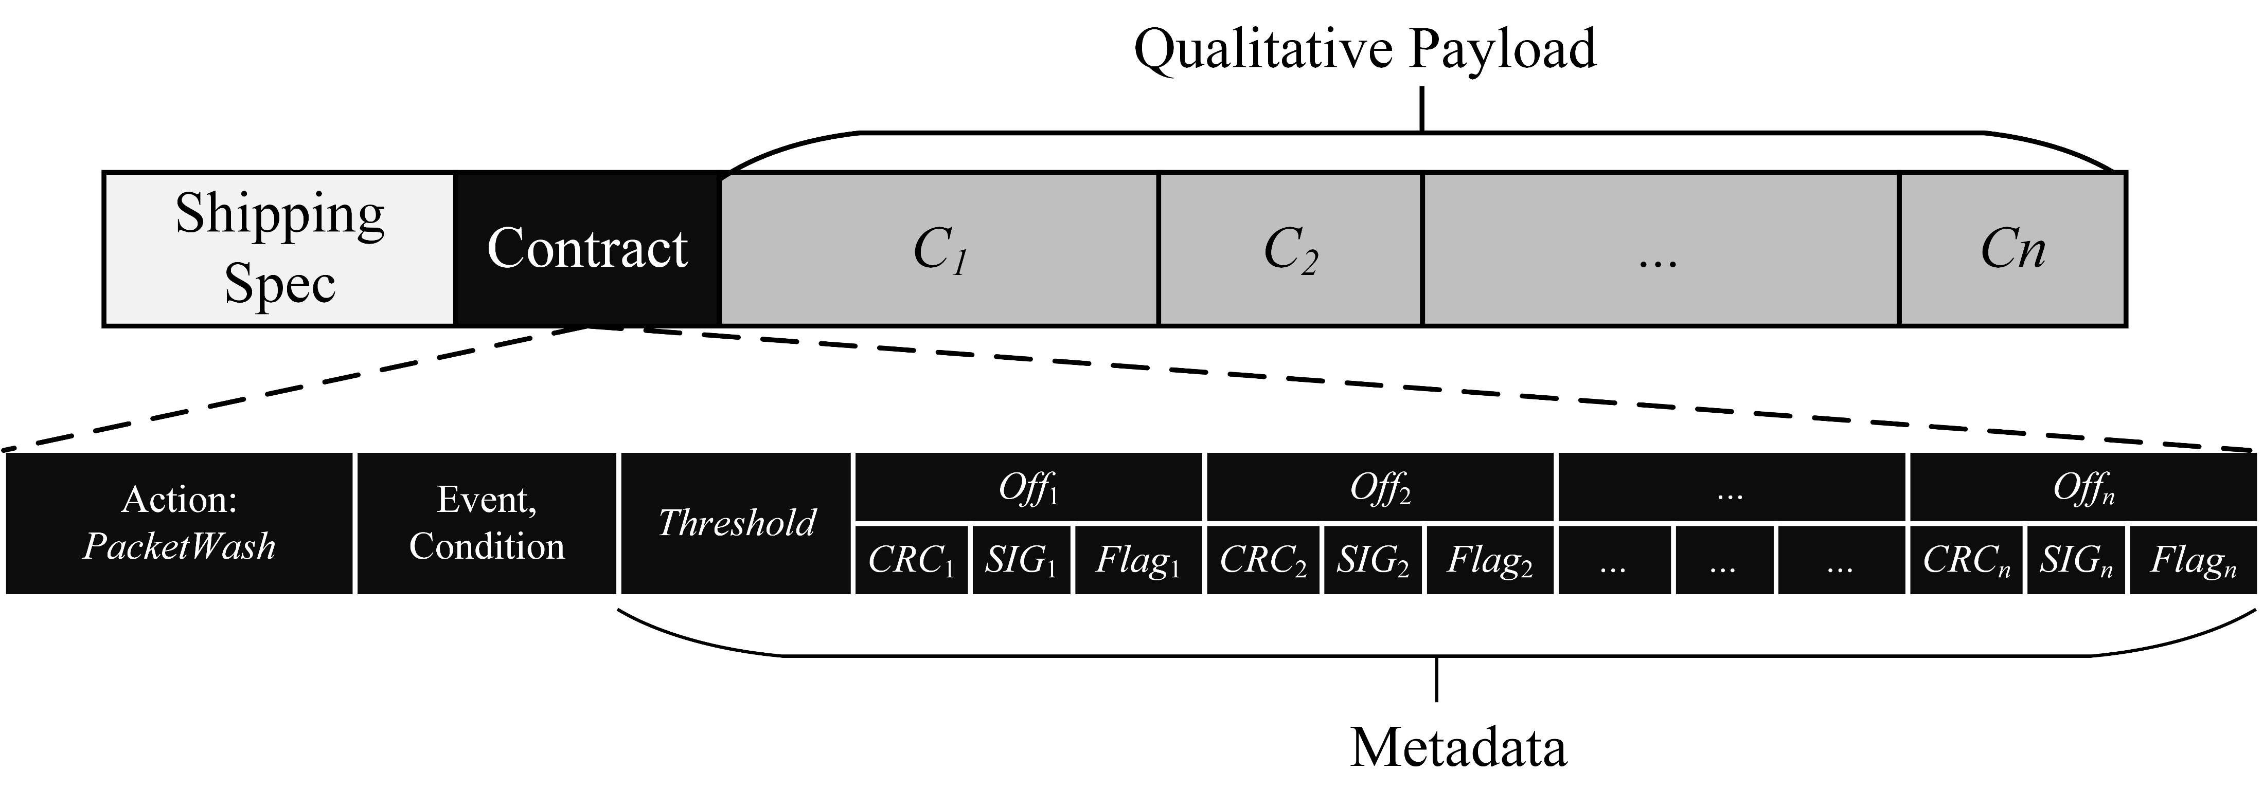
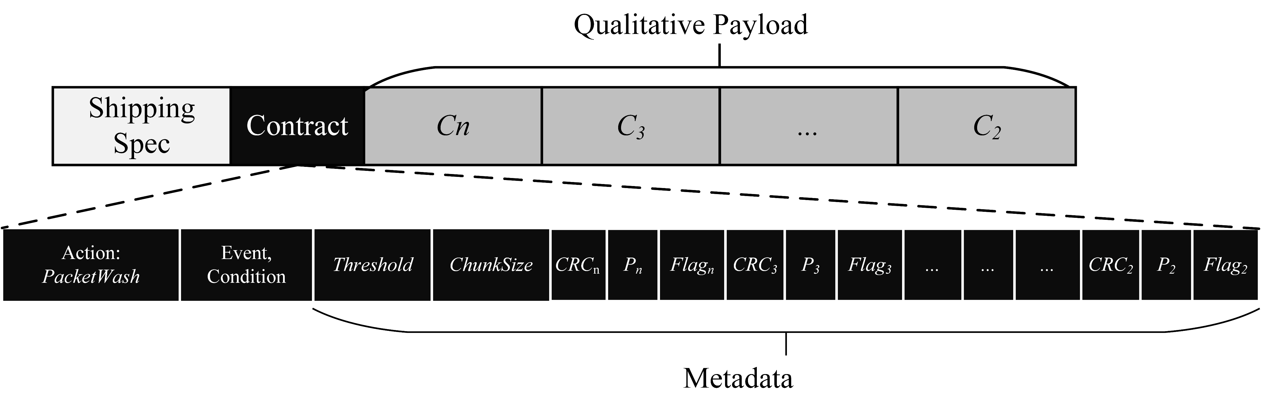
Significance based packetization

Slide 62
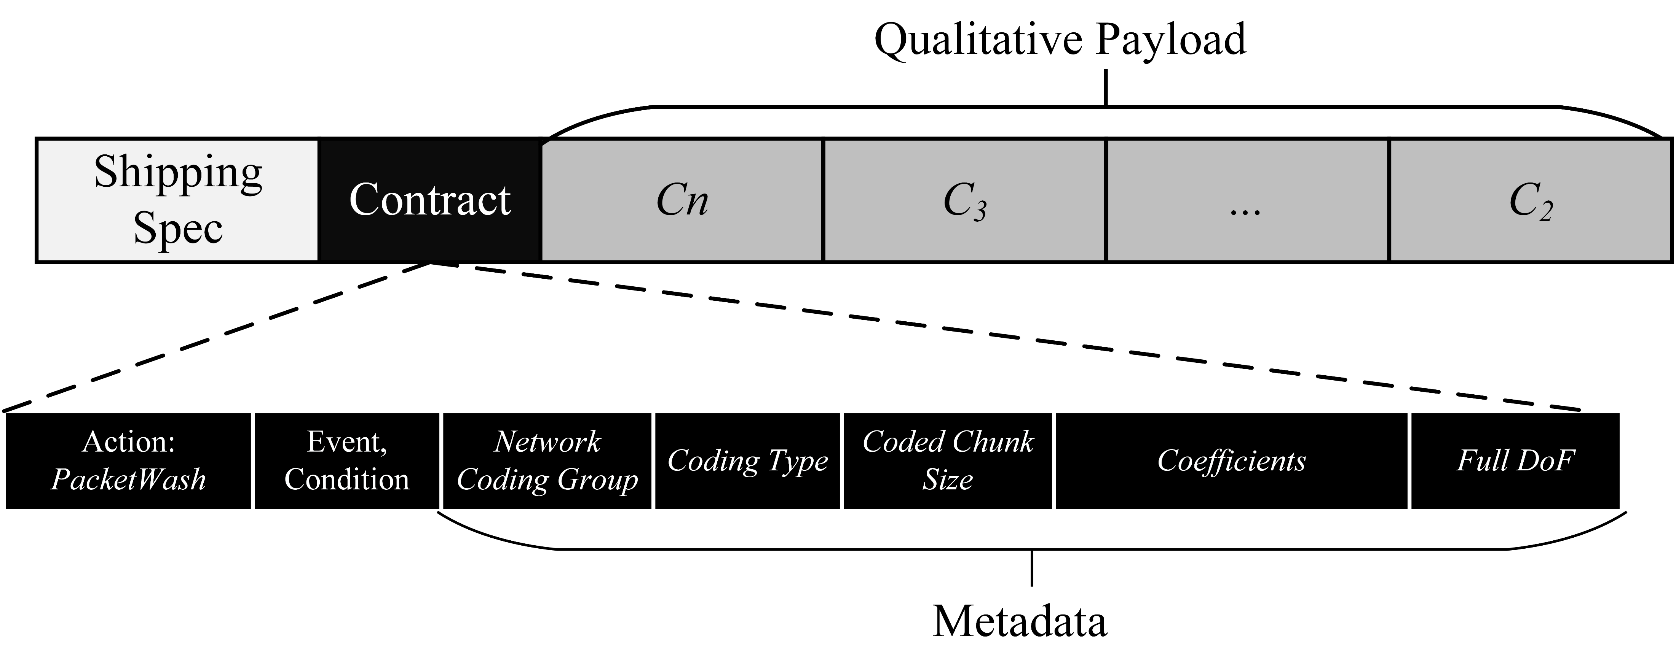
Random Linear Network Coding based packetization

Slide 63
New IP Enables Information Exchange Oriented Vehicle Clustering
Some vehicle may not have access to the infrastructure and needs other vehicle with Wifi or cellular interface to relay its data request to the infrastructure nodes and the data sent from the infrastructure nodes.
An information topic based clustering builds a collaborative vehicular system for information exchange being delegated to those vehicles that have infrastructure access and are willing to provide the service to other neighboring vehicles.
Action: forward to cluster head
Metadata: content identifier, topic name, cluster tag, aggregation permitted
Source: requesting vehicle IP address
Destination: content host IP address (could be set to cluster head IP address)
New IP packet for information request
Metadata: content identifiers, aggregation performed
Source: cluster head IP address
Destination: content host IP address
New IP packet for aggregated requests
Metadata: content identifier, offset in payload for corresponding data.
Source: requesting vehicle IP address
Destination: content host IP address (could be set to cluster head IP address)
New IP packet for concatenated data

Slide 64
References for Future Reading
Lijun Dong, Richard Li, Collaborative Computation in the Network for Remote Driving, IEEE SSCI, 2021.
Lijun Dong, Richard Li, “Distributed Knowledge Inference and Reasoning in the Network Based on New IP,” International Symposium on Networks, Computers and Communications (ISNCC), 2021.
Lijun Dong, Lin Han, “New IP Enabled In-Band Signaling for Accurate Latency Guarantee Service,” IEEE WCNC, 2021.
Lijun Dong, Alex Clemm, “High-Precision End-to-End Latency Guarantees Using Packet Wash,” IFIP/IEEE International Symposium on Integrated Network Management (IM), 2021.
Lijun Dong, Richard Li, “Optimal Chunk Caching in Network Coding Based Qualitative Communication,” Journal of Digital Communications and Networks, available online, June 2021.
Richard Li, Uma S. Chunduri, Alexander Clemm and Lijun Dong, “New IP: Enabling the Next Wave of Networking Innovation,” book chapter in “Design Innovation and Network Architecture for the Future Internet”, pp 1-42, DOI:10.4018/978-1-7998-7646-5.ch001, Jan 2021.
Lin Han, Lijun Dong, Richard Li, “A Study of In-Vehicle-Network by New IP,” The Thirteenth International Conference on Evolving Internet, 2021.
Lijun Dong, Kiran Makhijani, Richard Li, “Qualitative Communication Via Network Coding and New IP,” IEEE HPSR 2020.
Lijun Dong, Richard Li, “Scheduling of Complex Computation Offloading Tasks in Mobile Edge Cloud Network with New IP Framework,” IEEE World Forum on Internet of Things 2020.
Lijun Dong, Richard Li, “Packet Level In-Time Guarantee: Algorithm and Theorems,” IEEE Globecom 2020.
Lijun Dong, Richard Li, “Enhance Knowledge Inference and Reasoning by New IP,” IEEE iThings 2020.
Lijun Dong, Richard Li, “Semantics and Deviation Aware Content Request,” IEEE ISCC 2019.
Lijun Dong, Richard Li, “Information Exchange Oriented Clustering for Collaborative Vehicular System,” IEEE WOCC 2018

Slide 65
Thank You
Please contact presenters for questions, feedback, and comments
Mohit P. Tahiliani tahiliani@nitk.edu.in
Lijun Dong lijun.dong@futurewei.com
Bhaskar Kataria bhaskar.181co213@nitk.edu.in
Deepta Devkota deeptadevkota.191cs117@nitk.edu.in
Shashank D shashankd.181co248@nitk.edu.in
Kiran M kiranm@futurewei.com
Acknowledgements: @ameyanrd, @rohit-mp, @lesliemonis

